Slide 1

TECHNICAL SUPPORT SYSTEM
THOMAS MUTUKU – SCT121-0505/2019.

Slide 2
INTRODUCTION
One of the challenges our client is facing is that it does not have a proper channel for their customers to communicate with the firm directly to either book an appointment for a service to be offered.
The client needs an automated system which can help them to link with their customers and enable easier communication.

Slide 3
SYSTEM IMPLEMENTATION
The proposed system was implemented in order to fulfill and solve
Particular Objectives
Provide end user and manufacturer interaction
Booking appointments with technicians
Allow easy and fast servicing which includes remote troubleshooting
Technical consultation

Slide 4
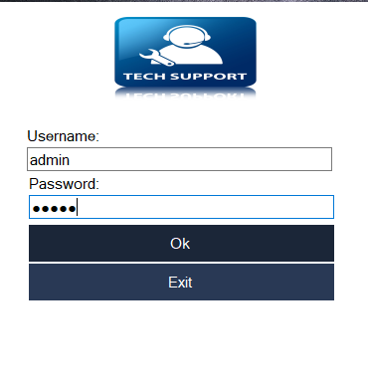
LOG IN INTERFACE
The System Supports an Admin and normal user Interface.
On logging in as An Administrator you are able to manage Technicians and Job orders that are made by the clients

Slide 5

ADMIN PANEL /USERINTERFACE
The admin panel provides a broad user interface that allows the users /administrator navigate access the TECH SUPPORT SYSTEM
The admin will be able to
Manage Customer
Manage Technician
Manage Job order
Manage Users
Generate Reports

Slide 6
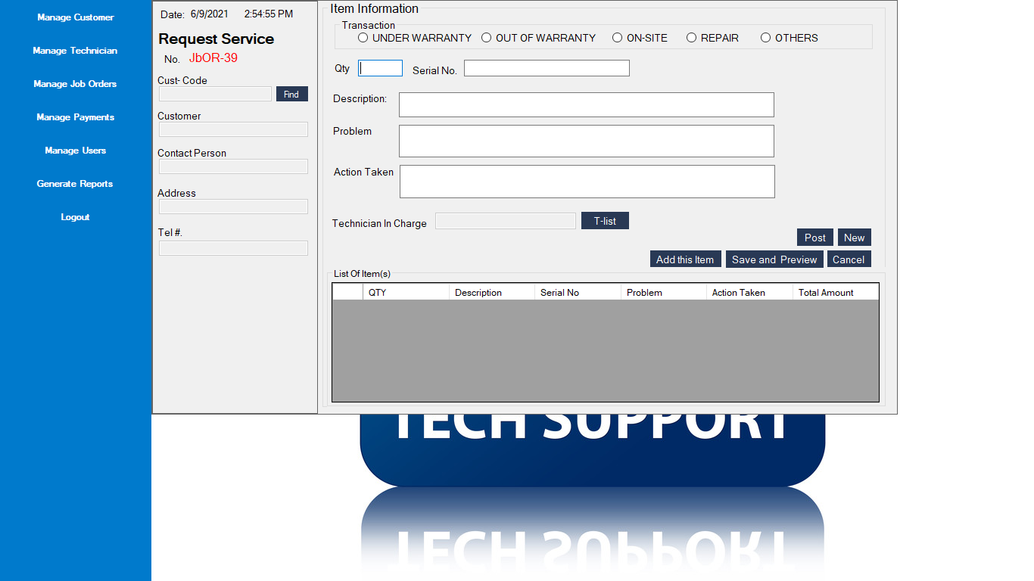
JOB ORDER/REQUEST SERVICE PANNEL
The Job Order /Request Panel Service Panel Enables the users to reach out to technicians by;
Describing the nature of the Job Or Service they want
IT also allows the Admin to manage the Technicians that should attend to particular Clients

Slide 7
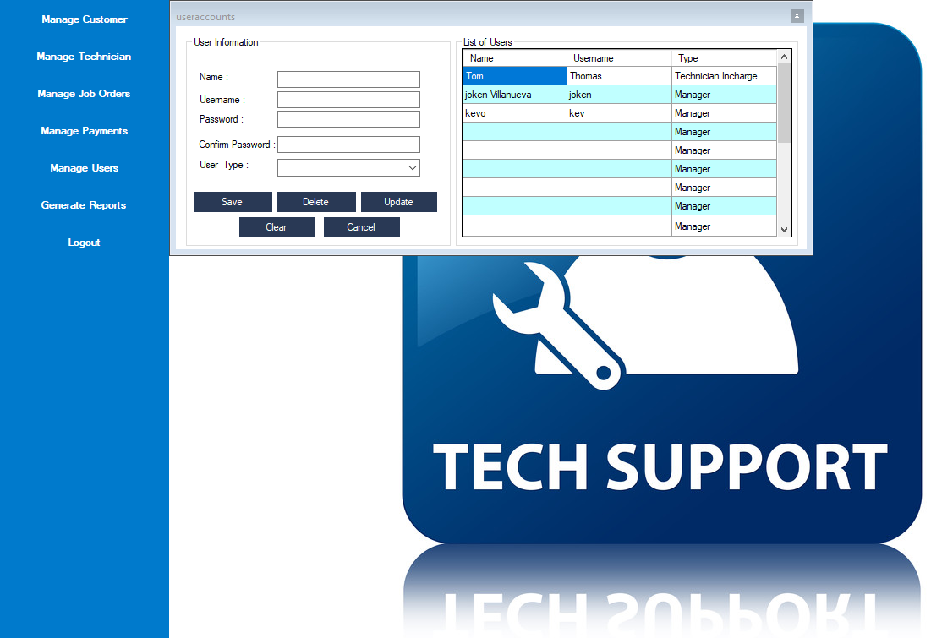
User Management
The Use Management panel enables the Administrator to add users to the system by :
Providing the User type
Update login Credentials
Manage Users
Update /Delete/Add new Users

Slide 8
SYSTEM FUNCTIONALITY DEMONSTATION
Now we will show a brief Demonstration of the implemented TECHNICAL SUPPORT SYSTEM

Slide 9
CONCLUSION
As show above the system gives a direct link for service provision
It reduces in convenience
RECOMMENDATION
A future Recommendation of the TECHNICAL SUPPORT SYSTEM version 1.1 which is in the process of being updated includes an additional module that will allow Technicians to perform Remote trouble shooting by accessing the clients machines or devices remotely and providing required services
An additional payment checking module will also be added to the TECHNICAL SUPPORT SYSTEM

